Slide 1

Simple Linear Regression
Michigan Hackers Machine Learning Team

Slide 2
Agenda
Icebreaker
Announcements
Review
Linear Regression
Implement Linear Regression in Python
Work and ask questions

Slide 3

Ice Breaker
Breakout into smaller groups and discuss an AI you’ve seen in a movie or TV show and how realistic it is.

Slide 4
Club Announcements
Office Hours will be held from 4:30-6:30 pm every Sunday over Zoom.
Come to office hours if you have any questions about the club or need help with machine learning concepts and/or python programming.
Textbook pdfs are available in the “Resources” folder in Google Drive
Become a core-member
If you have attended the last three meetings in a row, you will get an email from Michigan Hackers about how to become a core member

Slide 5
General Announcements
MDP Applications are now open!
The multidisciplinary design program is an opportunity for undergraduate students to participate faculty led research or industry sponsored teams to work on impactful projects and gain meaningful experience in academia or industry. Deadline to apply is October 18th.
MIDAS Seminar
Meet David Shor, a Super-Pac Data Scientist and learn about how data science and machine learning is being used in this election from data analysis to cybersecurity. Hosted by MIDAS.
Friday Night AI
A series of seminars hosted by the Michigan AI Lab about a wide variety of topics. The next one is on October 2nd about Artificial Intelligence to Address Misinformation and Fake News

Slide 6
Review

Slide 7
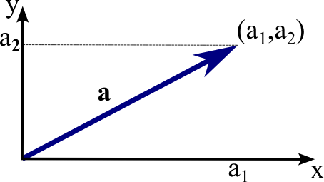
Vectors Review
A vector is a mathematical quantity that has both direction and magnitude. It is commonly represented as a directed line segment whose length represents the vector’s magnitude and orientation represents its direction. Ex: a = [2, 1]
Points are 0 dimensional in a Euclidean space. Points can be represented as vectors to give them dimensions. Storing points as vectors allows us to perform operations and calculations on the data.
Important Operations:
Additions/Subtraction Projection
Scalar Multiplication Angle Between Two Vectors
Dot Product Distance Between Two Vectors
Magnitude of a Vector

Slide 8

NumPy Review
NumPy (Numerical Python) is a library that adds support for multi-dimensional arrays along with mathematical operations.
To use numpy in python, write import numpy as np in the beginning of the script/notebook. All NumPy functions with descriptions can be found in the manual.
Important NumPy functions:
np.array(array_like)
np.dot(vec1, vec2)
np.sum(arr)
np.linalg.norm(vec)
Np.linalg sublibrary

Slide 9
Introduction to
Linear Regression

Slide 10
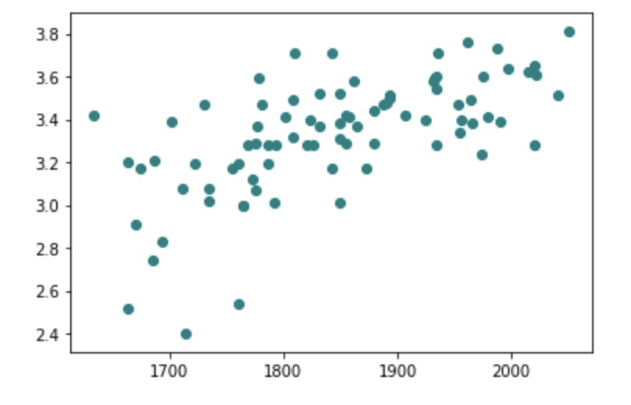
Linear Regression
Goal of Linear Regression: Given labeled training data, learn a linear function which predicts the continuous labels of test data as accurately as possible.
In other words: Given a labeled set of data, find the line of best fit.

Slide 11
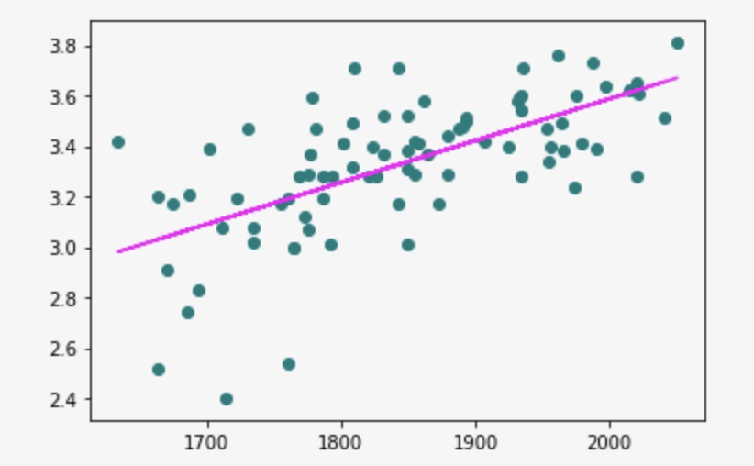
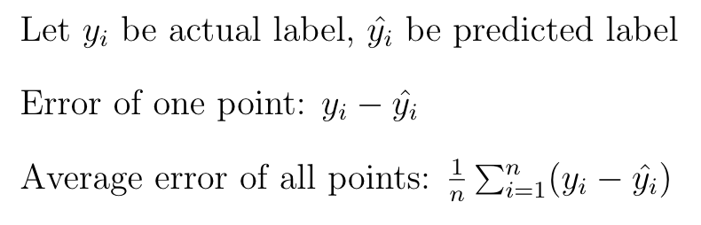
Measuring Error

Slide 12
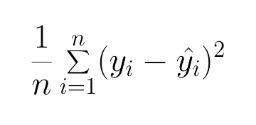
Mean Squared Error (MSE)
Idea: Punish large error even more. Make all errors positive so that you can minimize.

Slide 13
Linear Regression with MSE
Goal of Linear Regression with MSE: Given labeled training data, learn a linear function with the lowest MSE.
Consider a function which takes a line and a set of training data as input and outputs the MSE of the line with respect to the training data. Call this the loss function.
Reworked Goal: We want to find the line which minimizes the loss function.
This is an optimization problem.

Slide 14
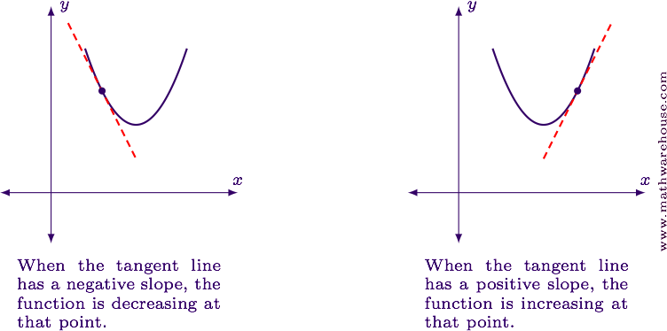
Gradient Descent (GD)
Gradient descent is a method for solving optimization problems.
Taking the gradient of a function at a point gives you the slope at that point.
Gradient is just like first derivative but can be applied in any dimension.

Slide 15
Gradient Descent (GD)
Idea: Start with a random point on a graph. Iteratively move in the opposite direction of the gradient of that point. Stop when your point doesn’t move much.
Step size is a parameter which determines how far your point moves at each iteration. This is also called the learning rate.

Slide 16
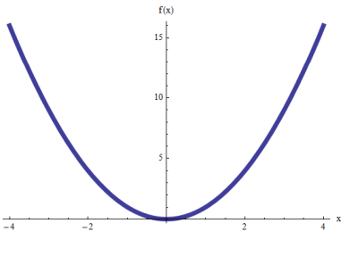
Linear Regression with MSE using GD
Given a labeled set of data, find a line of best fit by minimizing mean squared error (MSE) using gradient descent (GD).

Slide 17
Simple Linear Regression in Python

Slide 18
Work and Ask Questions

Slide 19
Work and Ask Questions
Questions about any topic, onboarding, or computer setup
For next week:
Beginner: Week 3 of Python 3 Programming Specialization on Coursera. Use the practice feature of the interactive textbook
Intermediate: Read chapters 4 and 5 in DSFS. Do examples in jupyter notebooks.
Advanced (already familiar with Python): Do the first project in Hands On Machine Learning, do pandas and numpy Kaggle tutorials, do Kaggle introductory competition (any of the above)

Slide 20

Thank You!
Michigan Hackers Machine Learning Team
Contact Info:
Rajas Gupta | rajasg@umich.edu
Vijay Shamra | vsharm@umich.edu
Provide Feedback

